Slide 1



FIXED INCOME SECURITIES – PART 1

Slide 2

DISCLAIMER
The training content and delivery of this presentation is confidential, and cannot be recorded, or copied and distributed to any third party, without the written consent of Imarticus Learning Pvt. Ltd.

Slide 3

YOU ARE GOING TO LEARN…
Fixed Income Securities & Terminology
Advantages of Fixed Income Products
Bonds and its Characteristics
Types of Bonds
Benefits & Risks involved in Bonds Investment
Money Market Products & types
REPO & Reverse REPO Agreements
Commercial Paper
Treasury Bills
Certificate of Deposits

Slide 4
FIXED INCOME SECURITIES
Fixed income securities, often referred to as debt securities, they are financial instruments that represent a loan made by an investor to a borrower. When you invest in a fixed income security, you are essentially lending your money to the issuer (the borrower) in exchange for periodic interest payments and the return of the principal amount at maturity.
Here are the key terminologies of fixed income securities:
1.Face Value/Par Value:
2. Coupon Rate:
Fixed income securities have a Face value / Par Value, which is decided by the Issuer company and this Face/Par Value decides the number of Debt Instruments in circulation for a given Debt Amount that the company wants to raise. This Face Value is the basis for calculation of Interest/Coupon Amount that will be paid to the investor.
The coupon rate, also known as the interest rate, is the annual rate of interest that the issuer agrees to pay to the bondholder. It's expressed as a percentage of the face value. For example, a bond with a $1,000 face value and a 5% coupon rate will pay $50 in interest annually.

Slide 5
FIXED INCOME SECURITIES
3. Maturity Date:
4. Coupon/Interest Payments Frequency:
Fixed income securities have a specific maturity date when the issuer is obligated to repay the principal amount to the bondholder. Maturity dates can range from a few months to several decades.
Debt Instruments holders receive periodic interest payments, typically semiannually or annually, throughout the life of the bond. These payments are based on the coupon rate and the face value.
5. Credit Quality:
6. Market Price:
Fixed income securities are assigned credit ratings by credit rating agencies (e.g., Moody's, Standard & Poor's etc.) to indicate the creditworthiness of the issuer. Higher-rated bonds are considered lower risk, while lower-rated bonds may carry higher risk but offer potentially higher returns.
The market price of a fixed income security can fluctuate based on changes in interest rates and the perceived credit risk of the issuer. If interest rates rise, the market price of existing bonds may fall, and vice versa.

Slide 6
FIXED INCOME SECURITIES
7. Yield:
8. Liquidity:
Yield represents the return an investor can expect to earn from a fixed income security. It takes into account the coupon rate, the bond's market price, and the time remaining until maturity. Yield can be expressed as current yield or yield to maturity (YTM).
The liquidity of fixed income securities varies depending upon the Issuer & Rating of the Instrument. Government Bonds, Govt Agency Bonds and Highly rated Corporate bonds tend to be more liquid, meaning they can be easily bought or sold in the OTC - Bond Dealers Market & Exchange Markets
9. Callability:
10. Use of Proceeds:
Bonds may have callable feature, meaning the issuer has the option to redeem the bonds before the stated maturity date. This allows issuers to take advantage of lower interest rates by refinancing their debt.
Fixed income securities can serve different purposes for issuers, including raising capital for investments, financing operations, or refinancing existing debt.

Slide 7
WHO CAN ISSUE FIXED INCOME SECURITIES?
Fixed income securities can be issued by a variety of entities, including governments, corporations, municipalities, and government-sponsored enterprises. Here are some of the key types of issuers of fixed income securities:
1. Governments:
Federal Governments:
National governments issue bonds, often referred to as government bonds or sovereign bonds, to finance public spending or manage national debt. These bonds are considered some of the safest investments because they are backed by the full faith and credit of the government.
State and Local Governments:
State and local governments like Municipal Corporations issue municipal bonds, also known as munis, to finance public infrastructure projects, schools, and other initiatives. Interest income from municipal bonds is often exempt from federal income taxes and, in some cases, state and local taxes.

Slide 8
WHO CAN ISSUE FIXED INCOME SECURITIES?
2. Corporations:
3. Government-Sponsored
Enterprises (GSEs):
4. Supranational
Organizations:
Companies issue Debt Instruments including Commercial Papers & Corporate bonds to raise capital for various purposes, including expansion, research and development, debt refinancing, and working capital. Corporate bonds vary in credit quality, with some issued by highly rated companies (investment-grade) and others by lower-rated or riskier companies (high-yield or junk bonds).
These are quasi-governmental entities created by the government to serve specific purposes in the housing and financial markets. Examples include US Govt Sponsored Agencies like Fannie Mae and Freddie Mac, which issue mortgage-backed securities (MBS) backed by pools of home mortgages.
International organizations like the World Bank and the International Finance Corporation (IFC) issue bonds to fund development projects in member countries. These bonds are often referred to as supranational bonds.

Slide 9
WHO CAN ISSUE FIXED INCOME SECURITIES?
5. Financial Institutions:
6. Utilities:
7. Other Entities:
Banks and Financial institutions issue various fixed income securities, including certificates of deposit (CDs) and Bonds, to raise capital and manage their liquidity.
Electric, gas, and water utilities may issue bonds to fund capital projects, such as building infrastructure or upgrading equipment. These bonds are often known as utility bonds.
Special purpose vehicles are used in structured finance to issue asset-backed securities (ABS), such as mortgage-backed securities (MBS) and collateralized debt obligations (CDOs).

Slide 10
ADVANTAGES OF FIXED INCOME SECURITIES
RSUs typically have a vesting period during which employees must remain with the company to receive the shares. This encourages employee retention.
1. Regular Income:
Fixed income securities provide a predictable and regular stream of income in the form of interest payments. This income can be especially valuable for retirees or investors seeking stable cash flows.
2. Preservation of Capital:
High-quality fixed income securities, such as U.S. Treasury bonds, are generally considered low-risk investments. They provide a high level of capital preservation, making them a safe haven for investors looking to protect their principal.
3. Diversification:
Fixed income securities can be an effective way to diversify an investment portfolio. They often have a low correlation with equities, which means they may perform differently in various market conditions, potentially reducing overall portfolio risk.
4. Predictable Cashflows:
Bonds with fixed interest payments and maturity dates offer a level of predictability that can help investors manage risk. Knowing when interest will be received and when the principal will be repaid can aid in financial planning.

Slide 11
ADVANTAGES OF FIXED INCOME SECURITIES
RSUs typically have a vesting period during which employees must remain with the company to receive the shares. This encourages employee retention.
5. Liquidity:
Many fixed income securities, particularly government and corporate bonds, are highly liquid, meaning they can be easily bought and sold in the secondary market. This provides investors with flexibility in managing their portfolios.
6. Tax Advantages:
Some fixed income securities, such as municipal bonds, offer tax advantages. Interest income from these bonds may be exempt from federal income taxes and, in some cases, state and local taxes.
7. Credit Quality Options:
Investors can choose fixed income securities with varying levels of credit risk based on their risk tolerance and return objectives. High-quality bonds offer lower yields but greater safety, while lower-rated bonds may provide higher yields with increased risk.
8. Portfolio Stability:
Fixed income securities can help stabilize a portfolio during periods of market volatility. When equity markets decline, the income from fixed income investments can offset losses.

Slide 12
ADVANTAGES OF FIXED INCOME SECURITIES
RSUs typically have a vesting period during which employees must remain with the company to receive the shares. This encourages employee retention.
9. Retirement Planning:
Fixed income securities can be valuable tools for retirement planning. Investors can build a laddered portfolio of bonds with staggered maturities to create a predictable income stream during retirement.
10. Inflation Protection:
Some fixed income securities, such as Treasury Inflation-Protected Securities (TIPS), are designed to provide protection against inflation by adjusting their principal value with changes in the Consumer Price Index (CPI).
11. Higher Claim on the Issuer’s Assets
Bondholders have a higher claim on a company's assets than equity shareholders in the event of bankruptcy. This can provide a degree of security, especially when investing in bonds issued by well-established companies.

Slide 13
DISADVANTAGES OF FIXED INCOME
RSUs typically have a vesting period during which employees must remain with the company to receive the shares. This encourages employee retention.
1. Interest Rate Risk:
Fixed income securities are sensitive to changes in interest rates. When interest rates rise, the market value of existing fixed income securities tends to fall, potentially leading to capital losses for investors who need to sell before maturity.
2. Reinvestment Risk:
In a falling interest rate environment, investors may face reinvestment risk when their fixed income securities mature or when interest payments are received. They may have to reinvest their funds at lower interest rates, resulting in reduced income.
3. Credit Risk:
The issuer's ability to make interest payments and repay the principal at maturity is a significant concern. Bonds issued by entities with lower credit ratings or in financial distress carry higher credit risk, increasing the chance of default.
4. Inflation Risk:
Fixed income securities with fixed interest payments may not keep pace with inflation, potentially eroding the purchasing power of future cash flows. This is especially relevant for bonds without inflation protection.

Slide 14
DISADVANTAGES OF FIXED INCOME
RSUs typically have a vesting period during which employees must remain with the company to receive the shares. This encourages employee retention.
5. Liquidity Risk:
While many fixed income securities are liquid, others, particularly those with lower credit ratings, may have limited liquidity. This can result in wider bid-ask spreads and difficulty in selling at desired prices.
6. Callable Bonds:
Bonds with call provisions give issuers the right to redeem the bonds before maturity. If a bond is called, investors may have to reinvest their funds at lower interest rates.
7. Market Risk:
Fixed income markets can experience price volatility due to economic conditions, geopolitical events, or changes in investor sentiment. This can impact the market value of bonds.
8. Complexity:
Some fixed income securities, such as structured products and complex derivatives, can be highly complex and difficult to understand. This complexity can lead to unexpected risks.

Slide 15
DISADVANTAGES OF FIXED INCOME
RSUs typically have a vesting period during which employees must remain with the company to receive the shares. This encourages employee retention.
9. Taxation:
Interest income from fixed income securities may be subject to income taxes at the federal, state, and local levels. The tax treatment can vary depending on the type of bond and the investor's tax situation.
10. Limited Growth Potential:
Unlike equities, fixed income securities do not provide direct ownership in a company and do not participate in the potential for capital appreciation to the same extent. The returns are primarily generated from interest payments.
11. Currency Risk:
For investors holding foreign fixed income securities, fluctuations in exchange rates can impact returns when converting interest and principal payments back into their home currency.

Slide 16
DISADVANTAGES OF FIXED INCOME
RSUs typically have a vesting period during which employees must remain with the company to receive the shares. This encourages employee retention.
12. Default Risk:
In extreme cases, an issuer may default on its obligations, leading to a loss of principal and unpaid interest for bondholders.
13. Low Yields in Low-Interest Environments:
In periods of historically low interest rates, fixed income securities may offer relatively low yields, potentially leading to reduced income for investors.

Slide 17
DID YOU KNOW?
Global Bonds
Global Traded Stocks
$70.1
Trillion
<
$92.2
Trillion
US Equity Market:
$27 trillion
US Bond Market:
$50 trillion

Slide 18

FIXED INCOME - MONEY MARKET – CMB
Cash Management Bill – CMB
Offered by the U.S. Treasury , CMB ‘s are a short-term security that is issued for a much shorter maturity period . They are issued for a period ranging anywhere between seven days to three months. CMBs can be purchased in $100 increments.
CMB are different from T bills in way they are issued for a shorter period of less than 90 days where as T Bill are issued for a period of more than 90 days to less than 1 year.
These securities are sold through auctions by the U.S. Treasury on its Treasury Direct website. The rates and yields during auctions are determined by the demand and their values fluctuate with interest rate changes and market demand.
Auctions are announced several days before they begin, with the amount to be auctioned and its maturity date. All auctions are open to the public and can be found on the Treasury's list of upcoming auctions.

Slide 19

FIXED INCOME - MONEY MARKET – T BILL
Treasury Bill (T-Bill)
T- Bills Primary Market Issue Process
T-Bills are short-term debt obligations issued & backed by the government. They are sold in denominations of face value of $1,000 and have a maturity of less than 1 year, such as a month, two months or six months.
T- Bills are discounted instruments in the sense they are issued at the discount & redeemed at the par
Example: A T-Bill from the US Government with a denomination or face value of $ 10,000 will be issued at a discounted price of $9800 for the duration of 3 months .Here the investors will pay $9,800 when issued & will collect $10,000 at redemption after 3 months, thus effectively earning a return of $200.
The securities are issued via a regularly scheduled auction process. Upon the Treasury’s announcement of the size of upcoming auction, tenders, or sealed bids are being solicited.
Bidders submit two types of bids:
Competitive Bidding: The Competitive Bidder category includes commercial bank & investment bank etc. and specifies the amount of the security that the bidder wants to buy ( Quantity ) and the price that the bidder wants to pay and in terms of Yield.
Non-Competitive Bidding: Non-competitive bidders are retail customers. They purchase low volumes and are not sophisticated enough to submit a bid. Limits on each non-competitive bid can be set. Direct purchases of Treasury securities by individuals are limited in many countries. In such cases they use the services of dealers.

Slide 20
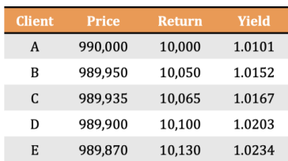
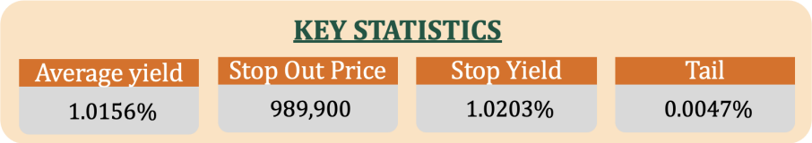
FIXED INCOME - MONEY MARKET – T BILL - BIDDING PROCESS
Assume that the Federal Reserve wants to issues T-Bills worth $4 million. Each bid is for a minimum 1 T-Bill; Cap: $1 million; Floor: $985,000. All competitive tenders are ranked in order of the bid yield. The lowest competitive bid is accepted first. As a result, the highest bid prices are accepted until the issue is sold out fully.
The Fed will issue its T-Bills to Clients A, B, C, and D, as they have bid for the highest price and lowest Yield. The price of the securities in the auction is set based on whether the auction was a discriminatory or uniform auction process.

Slide 21
FIXED INCOME - MONEY MARKET – REPURCHASE AGREEMENT (REPO)
1
The REPO transaction represents a loan backed by securities. Repurchase agreement (REPO) is a fully collateralized loan in which the collateral consists of marketable securities. The participants in a REPO transaction are banks, money market funds, and non-financial institutions.
2
Under the repurchase agreement (REPO) the borrower who borrows a certain sum also agree to sell the security to the Lender with an agreement that they will be repurchased at some specified date and price in the future.
3
The price difference between the sell & buy act as a compensation or interest charged for the amount lent. In an alternate scenario Repo also can be constructed where they agree to pay a fixed % of interest. On default, the lender has a claim on the securities.

Slide 22
FIXED INCOME - MONEY MARKET – REPURCHASE AGREEMENT (REPO)
4
For the party selling the security it is a REPO; For the party on the other end of the transaction, (buying the security and agreeing to sell in the future) it is a reverse repurchase agreement.
Basis of tenure, there are two types of REPO agreements:
Open REPO: There is no set maturity date, but renewed each day upon agreement of both counterparties.
Term REPO: It is a REPO with a maturity of more than one day.
5
6
There is NO secondary market for REPOs. The transactions can amount to USD 10 million. Maturity can range from 1-15 days and for one, three, or six months.

Slide 23
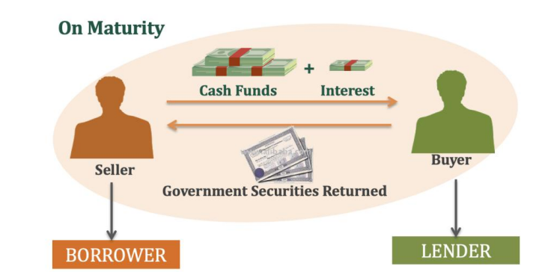
FIXED INCOME - MONEY MARKET – REPURCHASE AGREEMENT (REPO)
REPO and Reverse REPO Deals REPO deals are quoted on a yield basis. The rate is quoted as a simple interest yield on a 360 days basis. This is set upon initiation of the transaction and fixed for the term of REPO. REPO transactions have two legs:
Leg 1 or Opening leg: When cash is borrowed against collateral
Leg 2 or Closing leg: Where REPO (repurchase ) transaction takes place, i.e. securities are repurchased by repaying REPO loan plus interest.
In a Leg-2 of REPO transaction, the payment is calculated:
Reverse principal + Interest = Reverse Principal x (1 + (y x t / 360))
Where,
Y = Yield or Repo Rate and T = Maturity of the Reverse REPO.
Difference between REPO and Reverse REPO:
Under Reverse REPO, the buyer of the security has the right to sell back/surrender the security at a future date at a higher price.
Under REPO, the seller of the security has the right to repurchase the security at a future date at a higher price.

Slide 24
FIXED INCOME - MONEY MARKET – COMMERCIAL PAPER
Commercial paper
Commercial paper are unsecured promissory notes for a specified amount to be paid at a specified date. It is issued by large corporations to meet short-term debt requirements and they are issued at discount & redeemed at par . The issuers are finance companies and banks, but also include corporations with strong credit, and even foreign corporations and sovereign issuers.
They are issued by large corporations at a discount for 1 to 270 days.
The Yield is higher for commercial papers compared to T-Bills.
The buyers include mutual funds, banks, insurance companies, and pension funds because commercial paper is usually sold in round lots of $100,000.
Financial Corporations sell 2/3rd of total commercial paper, and sell their issues directly to the public.
Corporations that borrow less frequently sell commercial papers, which are known as Industrial Papers, to paper dealers and charge a markup and sell to investors
Notes:
Anshul’s observations:
Advantage Point 3 - “Less international regulation” - Can be elaborated further…
Disadvantages also are not very clear -
Would the higher administrative cost result in less capital raised for the Co ? Need to added as speaking Points
If a US investor is buying ADR, then why would he/she need to do FX transaction ? Need to added as speaking Points
Transaction costs & listing costs ? Need to added as speaking Points

Slide 25

Fixed Income - Bonds

Slide 26
BONDS
A bond is a fixed income security that represents a loan made by an investor to a borrower. When you purchase a bond, you are essentially lending your money to the issuer (which could be a government, corporation, or other entity) in exchange for periodic interest payments and the return of the bond's face value (or principal) at maturity.
Key Components of a Bond:
01
Face Value (Par Value): This is the initial amount of money borrowed by the issuer, which will be repaid to the bondholder at the bond's maturity date.
02
Coupon Rate: The coupon rate, also known as the interest rate, is the annual rate at which the issuer agrees to pay interest to the bondholder. It's typically expressed as a percentage of the bond's face value.
03
Maturity Date: This is the date on which the issuer is obligated to repay the bond's face value to the bondholder. At maturity, the bond "matures," and the investor receives the principal amount.

Slide 27
BONDS
Interest Payments (Coupons): Bondholders receive periodic interest payments, usually semi annually or annually, throughout the life of the bond. These payments are calculated based on the coupon rate and the bond's face value.
04
Yield: The yield is the total return an investor can expect to earn from a bond. It takes into account the coupon rate, the bond's market price, and the time remaining until maturity. Yield can be expressed as the current yield or the yield to maturity (YTM).
05
Market Price: The market price of a bond can fluctuate based on changes in interest rates and the perceived credit risk of the issuer. If interest rates rise, the market price of existing bonds may fall, and vice versa.
06
07
Issuer: This is the entity that borrows money by issuing the bond. It can be a government (in the case of government bonds), a corporation (for corporate bonds), or other entities.
Bonds are commonly used by both governments and corporations to raise capital for various purposes, including financing projects, refinancing debt, or covering operating expenses. They are considered relatively lower-risk investments compared to stocks because they provide a predictable stream of income in the form of interest payments and the return of principal at maturity.

Slide 28
CASH FLOW OF A BOND
Yield
Example: Bond Details:
Issuer: XYZ Corporation & Par/Face Value of the Bond is : $1,000
Issue Price : $1,000
Coupon Rate: 5% annually
Maturity: 12 years
Redemption Price : $ 1000
Cash Flows:
Purchase of Bond: When you purchase the bond in Primary Market at the time of Issue, you pay the face value of $1,000 to XYZ Corporation.
Year 1 - Interest Payment: Since the coupon rate is 5%, XYZ Corporation will pay you 5% of the face value as interest annually. In the first year, you will receive an interest payment of $50 (5% of $1,000).
Cash Inflow: $50 (Interest Payment)
Year 2 - Interest Payment: In the second year, you will receive another interest payment of $50.
Cash Inflow: $50 (Interest Payment)
Years 3 to 11 - Interest Payments: For the remaining years until maturity, you will continue to receive annual interest payments of $50.
Cash Inflow: $50 (Interest Payment) each year from Year 3 to Year 9
Year 12 - Maturity: At the end of the 12th year, you will receiveboth coupon amount of $50 and the redemption price of the bond, which is $1,000. Total Cash Inflow: $1,050 (Redemption Price + Interest)

Slide 29
CASH FLOW OF A BOND
The cash flows of a 5% coupon bond having FV=1000 with a maturity of 12 years will look like:

Slide 30
CASH FLOW OF A BOND
Here's a summary of the cash flows for this bond over its 12-year life:
Total Interest Payments: $50 x 12 years = $600
Return of Principal: $1,000
So, the total cash inflows you will receive from this bond over its life are $600 in interest payments and $1,000 at maturity, resulting in a total cash inflow of $1,600. This represents the return you'll earn from investing in this bond.

Slide 31

BOND TYPES - GOVERNMENT BONDS
A government bond is a bond issued by a national government, generally with a promise to pay periodic interest payments and to repay the redemption value on the maturity date.
aka Sovereign Bonds
The US Treasury Bond market has daily trading volume of $910 billion.
Did You Know?

Slide 32
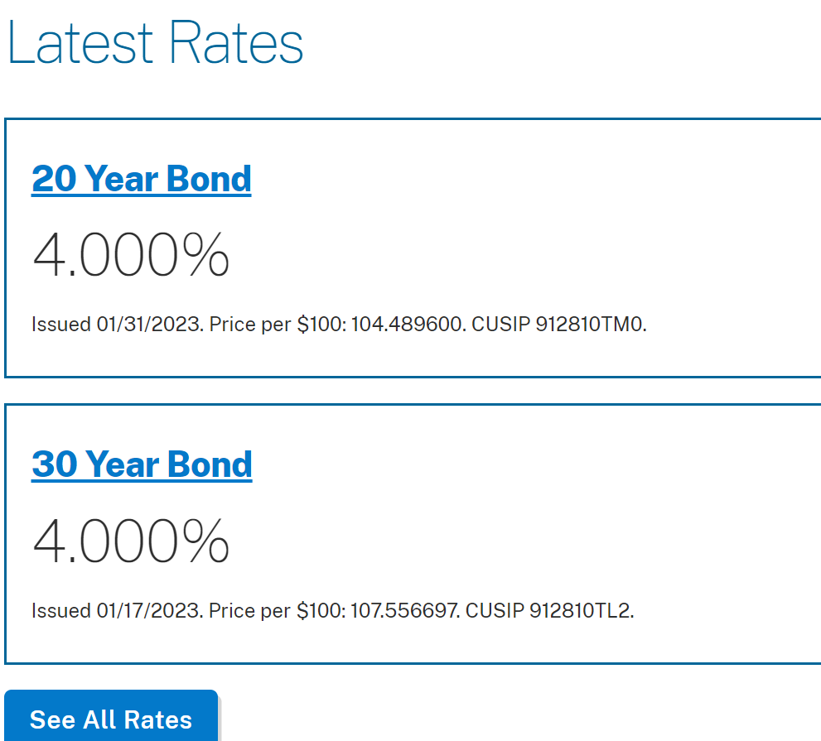
TREASURY BONDS
Treasury Bonds:
A Treasury Bond is a bond issued by the Government and are issued for a term of 20 to 30 years. These bonds pay a fixed rate of interest through out the life of the bond and the interest is paid on semi annual basis.
Non competitive sector can buy for a minimum of $100 and in the increments of $100. The maximum investment allowed is $10 million.
The auction frequency is 4 per year for the Original issues ( issued for the first time) and 8 per year for the subsequent issues.
Investments in T bonds are exempted from the provincial or municipal taxes , however no such exemptions are available for the federal tax.

Slide 33
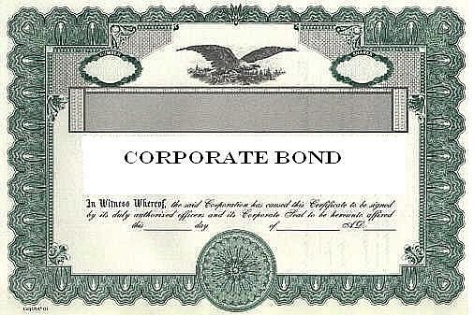
BOND TYPES - CORPORATE BONDS
A corporate bond is a bond issue by a corporation.
It is a bond that a corporation issues to raise money effectively in order to expand its business.
The term is usually applied to longer- term debt instruments, generally with a maturity date falling at least a year after their issue date.
Corporate bonds are often listed on major exchanges (listed bonds) and Electronic Communication Networks
The coupon (i.e. interest payment) is usually taxable.
The US corporate bond market has daily trading volume of $ 36 Billion.
Did You Know?

Slide 34

FOREIGN CURRENCY BONDS
Foreign Currency Bond are bonds which are issued by Governments and large Corporate entities in a foreign country to raise capital.

Slide 35
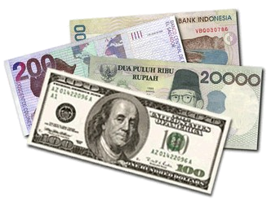



FOREIGN CURRENCY BONDS
Issued in foreign currency to raise capital
Take advantage of differences in the interest rates.
To raise desired Foreign Currency Capital
Issued in US
Yankees($) Bonds
Bulldogs(€) Bonds
Yankee ($)
Bulldogs(€)
Samurai(¥)
Issued in UK
Issued in Japan
Samurai(¥) Bonds

Slide 36

FOREIGN CURRENCY BONDS
Euro Bond
A Euro bond is an international bond that is denominated in a currency not native to the country where it is issued.
Euro bonds are named after the currency they are denominated in. For example, Euroyen and Eurodollar bonds are denominated in Japanese yen and American dollars respectively.
The first European Eurobonds were issued in 1963 by Italian motorway network Autostrade. The $15 million six year bonds was arranged by London bankers S. G. Warburg.

Slide 37
BONDS
Floating Rate Notes
Callable Bonds
Puttable Bonds
A floating-rate note (FRN) aka Floaters is a debt instrument issued fo a period of 2 – 5 years .They pay a variable interest rate tied to a benchmark rate like US Treasury note rate, the Fed funds rate etc.
FRN’s can be issued by financial institutions, governments, and corporations in maturities of two-to-five years.
Floating-rate notes have quarterly coupons, meaning that they pay interest four times a year, however the coupons can be also paid monthly, semiannually, or annually.
A callable bond is a bond that can be redeemed by the issuer prior to its maturity. Usually a premium is paid to the bond owner when the bond is called. These are also known as ‘redeemable bonds.’
A company can call back the bonds if the interest rate falls in the market , so that the bonds can be financed at a cheaper rate.
A bond with an option to sell back or put the bond to the issuer before maturity. The holder of the puttable bond has the right, but not the obligation, to demand early repayment of the principal.
It can be done so that the holder can sell it back to a company incase he thinks that the credit worthiness of the issuing company is falling or if the interest rate in the market is increasing and the investor can invest in a bond that pays higher interest rate.

Slide 38
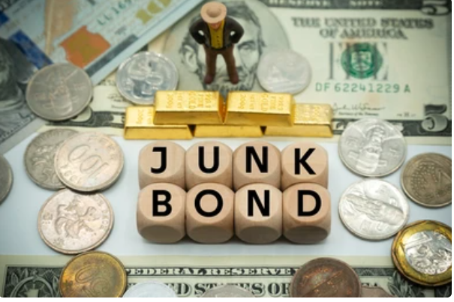
JUNK BONDS / HIGH YIELD BONDS
The credit risk on these bonds is high.
Your high risk provides a high coupon rate.
Junk bonds are Debt Instruments with a poor credit rating which carries significant credit risk, which affects the probability of repayment of the bonds.

Slide 39

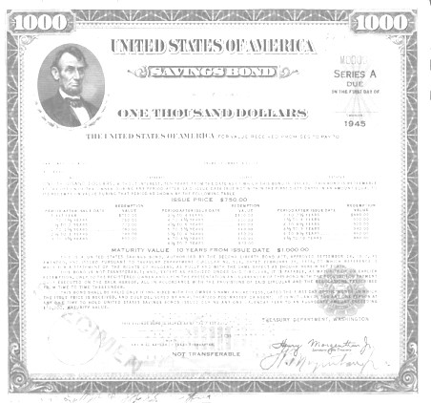




OPTIONALLY CONVERTIBLE BONDS
LATER
Convertible Bond
Option to convert
in to Equity Shares
Equity
XYZ Supermarket Publicly Listed
Investor
Convertible Bond

Slide 40
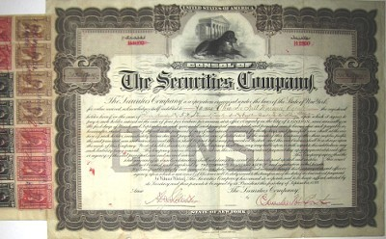

PERPETUAL / IRREDEEMABLE BONDS
Perpetual bond is a bond with no maturity date. Interest will be paid “forever”
Issuers makes Interest payment as long as the bond is held
Issuers pay coupons on Perpetual bonds forever, and they do not have to redeem the principal.
Predictable sources of income
High credit risk
If market interest rates rise, bond prices falls in value.

Slide 41



DEFERRED COUPON BONDS
Deferred Bond
Deferred Coupon Bonds are those Bonds wherein Coupon Payments are deferred and paid only upon maturity.
Unlike most bonds, a deferred bond does not make periodic, or "coupon," payments over its lifetime.
Instead, the interest accrues and is paid out when the bond expires/ matures.
ABC Car Wash
Investor
$1000
ON MATURITY
$1000 + Coupon/Interest
ABC Car Wash
Investor
$1000

Slide 42


DEFERRED BONDS
No “periodic” interest/coupon is paid each year.
All agreed coupons/interest amount accumulated (adjusted for time value) and is paid out on the date of maturity of the bond.
Good for those who want to save money while accruing more interest

Slide 43
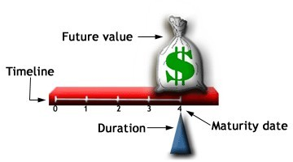
ZERO COUPON BONDS
A zero-coupon bond is also called as Deep Discount Bond and this bond isused at discounted price (issued at a discount to Par/Face Value) and this Bond is redeemed at the face value at the time of maturity (redeemed at par).
It does not make periodic interest payments, or have so-called "coupons", hence the term zero-coupon bond.
When the bond reaches maturity, its investor receives its par (or face) value.
The difference between the purchase price and redemption price is the coupon income amount for the Investors.

Slide 44

INFLATION INDEXED BONDS
Inflation-indexed bonds are bonds where the principal/interest is indexed to inflation like RPI (Retail Price Index). They are thus designed to cut out the inflation risk of an investment.

Slide 45
INFLATION INDEXED BONDS - EXAMPLE
End of the 1st year | End of the 2nd year
Principal : Rs. 1000 | Principal : Rs. 1030
Inflation in the economy : 3 percent | Inflation in the economy : 6 percent
Inflation accrual : Rs. 30 | Inflation accrual : Rs. 61.8
Principal at the end of the first year : Rs. 1030 | Principal at the end of the 2nd year : Rs.1091.8
Promised rate of return : 3 percent | Promised rate of interest : 3 percent
Interest : 1030 x 3/100: Rs 31 | Interest : 1091.8 x 3/100: Rs. 32.7
Note: The inflation component is adjusted in the principal & interest is paid on this adjusted Principal Amount. At the time of redemption, adjusted principal or the face value, whichever is higher, would be paid.

Slide 46



THANK YOU !!!
Contact us today! https://imarticus.org/

